Slide 1

CVR COLLEGE OF ENGINEERING
Department of CSE(AI&ML)
Real-Time / Field-Based Research Project Stage -2
FOCUS SENSE
Under the guidance of
Dr N. HANUMANTHARAO
Associate Professor
Team Members:
A. HARINIVAS REDDY–24B81A66E7
MD. ABUL AZEEM– 24B81A66D1
G. HARSHAVARDHAN –24B81A66E8

Slide 2
Abstract
Focus Sense is an AI based system designed to monitor user concentration levels.
The system targets students, undergraduates, and professionals facing difficulty in maintaining focus.
It uses Machine Learning and Convolutional Neural Networks (CNN) for classification.
OpenCV is used for real-time video processing through a webcam.
The system aims to reduce distractions and enhance work efficiency.

Slide 3
Introduction
Maintaining focus has become increasingly difficult in today’s digital environment due to constant exposure to social media and multiple tasks. These distractions reduce attention span and negatively impact productivity and efficiency.
Lack of concentration affects productivity of students and professionals.
Focus Sense is an AI based system to monitor user attention in real time.
Helps improve productivity through real-time monitoring and feedback.

Slide 4
Problem definition
Many students and professionals struggle to maintain focus during study and work sessions.
Frequent distractions such as social media, mobile apps, and multitasking reduce productivity.
Existing tools do not accurately monitor real-time user attention.
Lack of automated systems to detect whether a person is focused or distracted.
Need for an intelligent system that can monitor, analyze, and improve user concentration.

Slide 5
Existing System
Existing System / App | Disadvantages
Timer-based apps (Pomodoro, etc.) | Do not track actual user attention
App/Website blockers (Freedom, Cold Turkey) | Only block apps, no attention analysis
Time tracking tools (RescueTime) | Only show usage statistics, no real-time intervention
Manual self-discipline methods | Not reliable and lack automation
Basic focus apps (Forest) | Gamified but no actual behavior tracking

Slide 6
Proposed System
Uses AI to monitor real-time focus.
Combines blocking with attention detection.
Provides real-time classification (Focused/ Distracted).
Fully automated system using ML/CNN.
Tracks eye gaze and head pose for accuracy.
Constant live webcam for 30 frames per second for classification.

Slide 7
Objectives-features
To develop an AI-based system for monitoring user concentration in real time.
To track eye gaze using computer vision techniques.
To analyze head pose for detecting attention levels.
To classify user state as Focused or Distracted using ML/CNN models after training and evaluating.
To provide real-time feedback on user attention.

Slide 8
Software Requirements
Languages: Python
MAIN LIBRARIES: OpenCV, TensorFlow / Keras ,NumPy, Pandas, Mediapipe.
Database:
Tools/IDEs: VS Code

Slide 9
Hardware Requirements
RAM: MINIMUM 8 GB RAM
Disk Space:10 GB FREE SPACE
Operating System: WINDOWS
Processor: INTEL i5 OR ABOVE

Slide 10
PROPOSED SYSTEM ARCHITECTURE
Web Cam Input
Video Capture
Face Detection
Eye Gaze Tracking
Head Pose Estimation
Feature Extraction
CNN / ML Model
Focus Classification
Action Module
Log Record

Slide 11
Functional requirements
The system should capture real-time video using a webcam.
The system should track eye gaze movement.
The system should analyze head pose.
The system should process input data using ML/CNN models.
The system should classify the user as Focused or Distracted.
The system should provide real-time feedback to the user.

Slide 12
Non-Function Requirements
The system should have high accuracy in detecting focus levels.
The system should provide real-time performance with minimal delay.
The system should be user-friendly and easy to use.
The system should be reliable and stable during operation.
The system should ensure data privacy (no unnecessary data storage).
The system should be efficient in resource usage (CPU, memory).
The system should be scalable for future improvements.

Slide 13
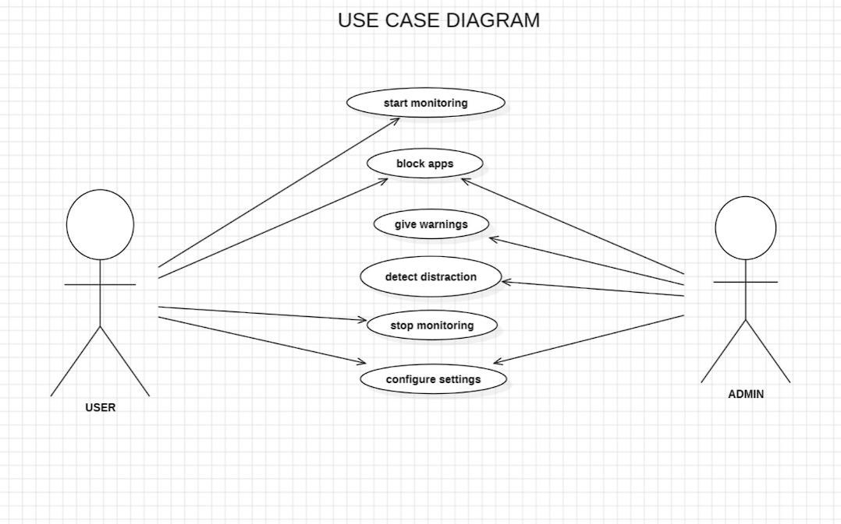
Use Case Diagram

Slide 14
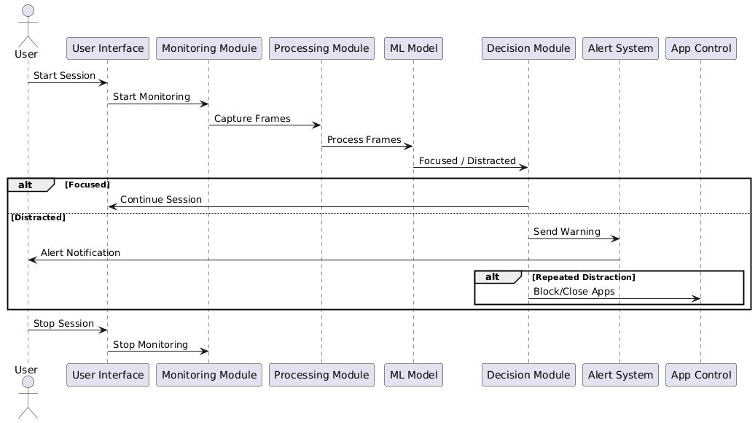
Sequence Diagram

Slide 15
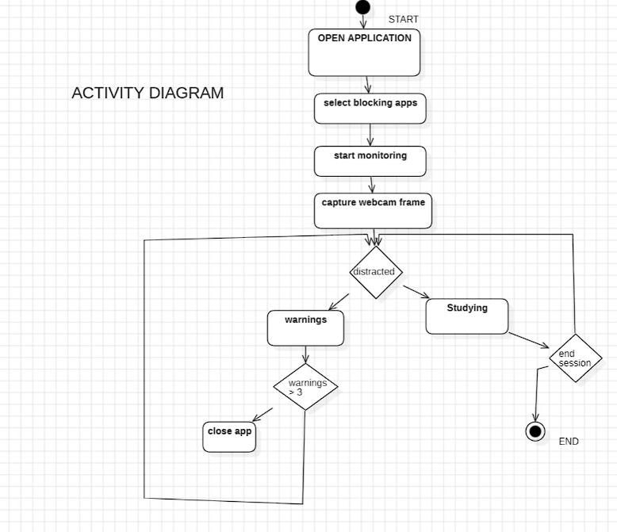
Activity Diagram

Slide 16
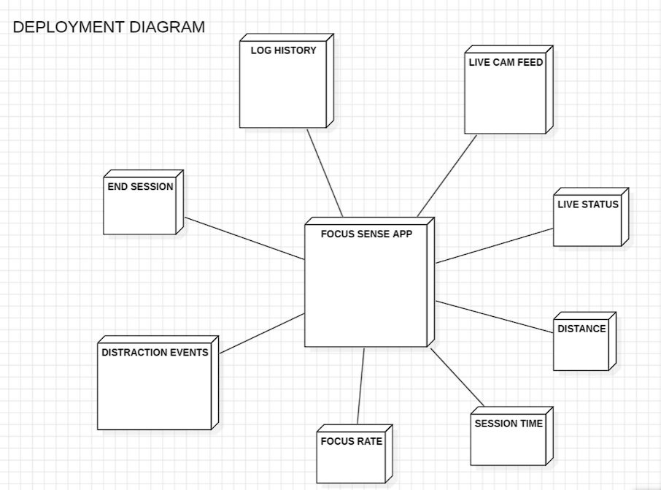
Deployment Diagram

Slide 17
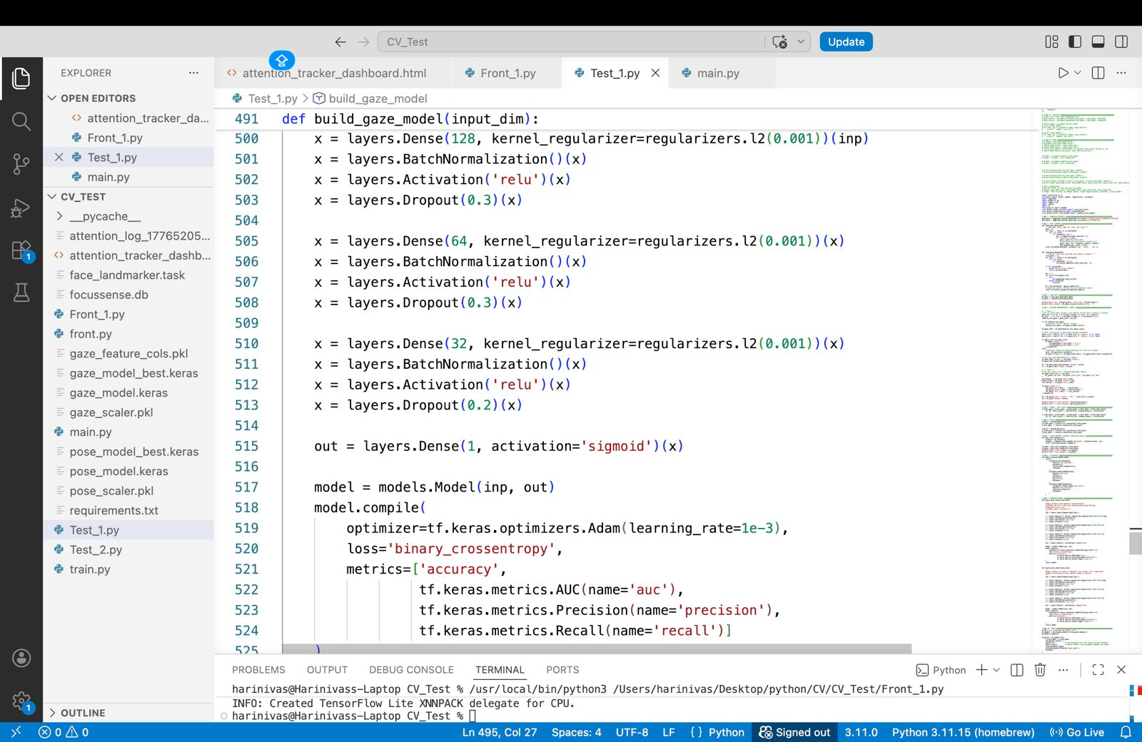
Methodology Implementation along with Sample Code

Slide 18
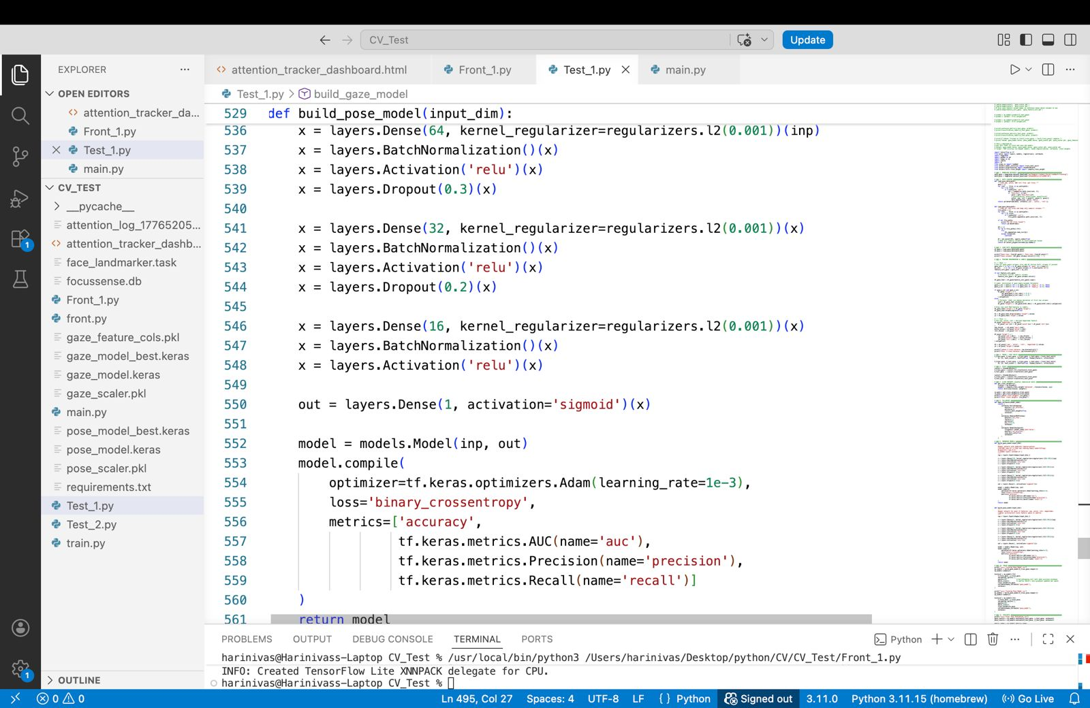

Slide 19
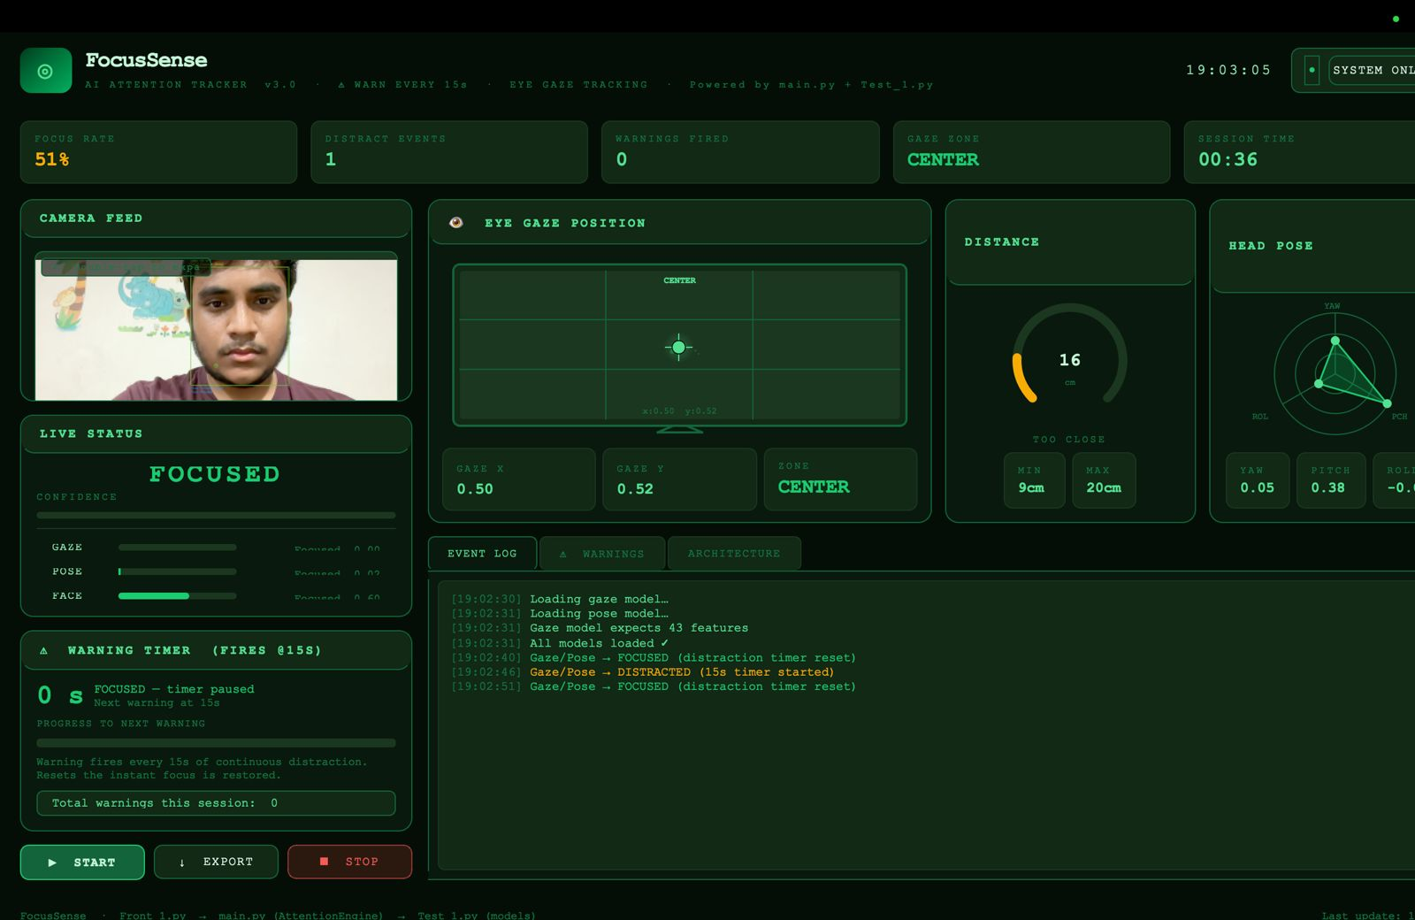
Result:

Slide 20
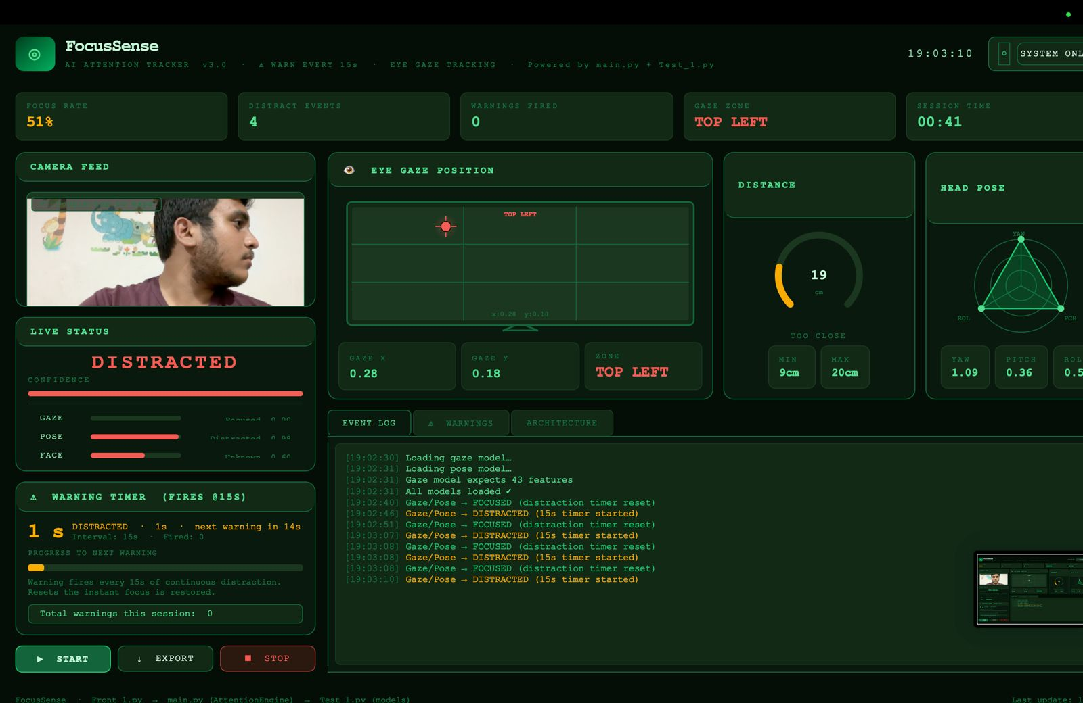

Slide 21
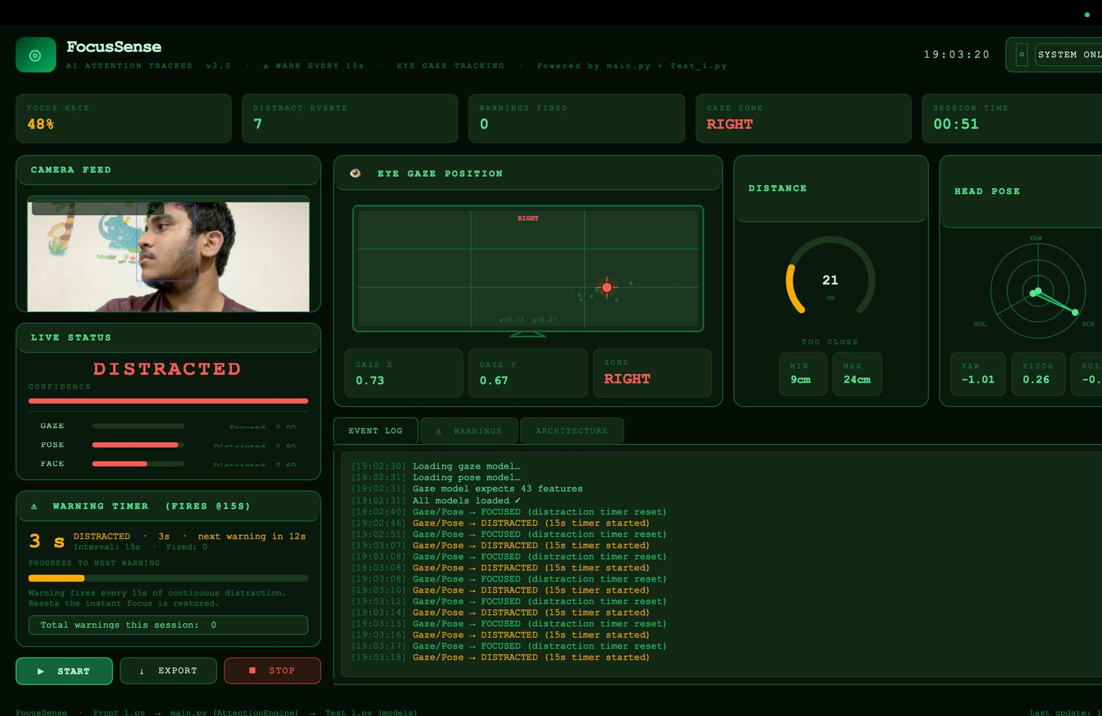

Slide 22
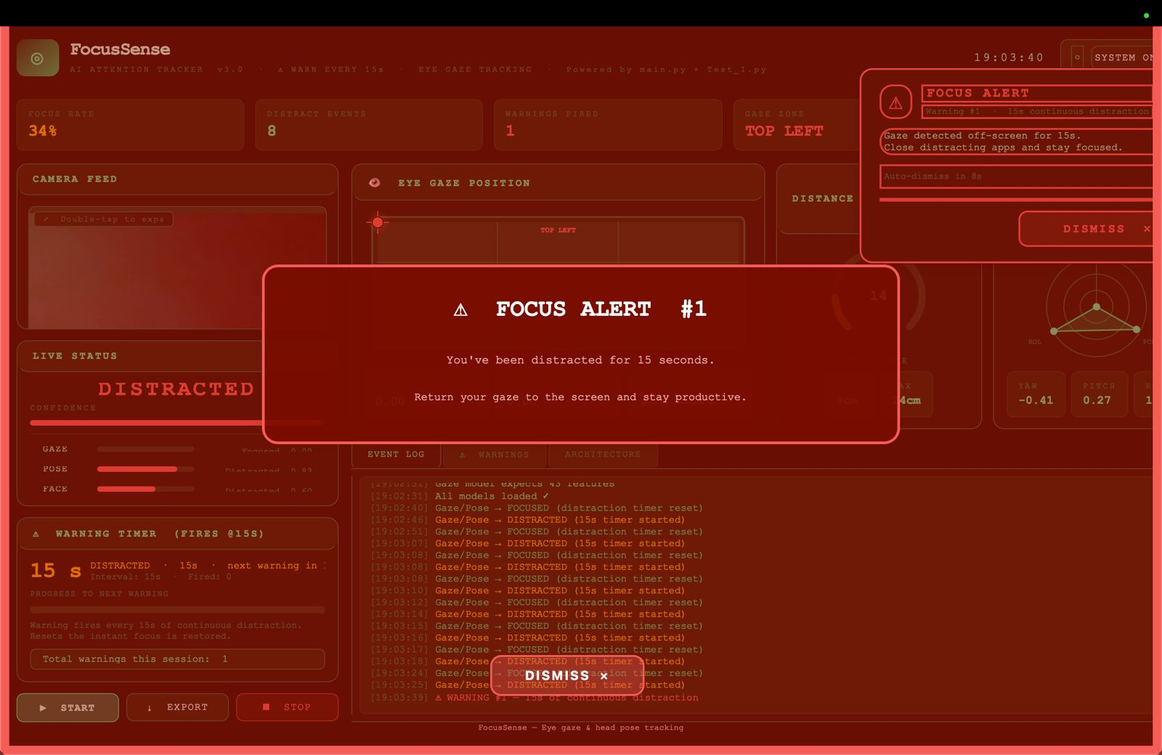

Slide 23
Conclusion
The system successfully implements real-time user attention monitoring using Computer Vision techniques.
The system demonstrates a practical integration of machine learning and system-level controls for productivity enhancement.
Overall, the solution is lightweight, modular, and suitable for real-world deployment in academic and professional environments.

Slide 24
FUTURE SCOPE
A multi-level warning system (with alerts and sound notifications) ensures user awareness before enforcing restrictions.
Development of a cross-platform system (Windows, Linux, Android).
Integration with cloud services for logging, analytics, and performance tracking.

Slide 25
References
[1]. Hands-On Machine Learning with Scikit-Learn, Keras & TensorFlow (2nd Edition Updated for TensorFlow 2 ) by OREILLY
[2]. Tensorflow Documentation An End-to-End Open Source Machine Learning Platform. Available at: https://www.tensorflow.org/
[3]. GeeksforGeeks. Face Detection using Python and OpenCV. Available at: https://www.geeksforgeeks.org/face-detection-using-opencv-python/

Slide 26
Thank you

